Slide 1
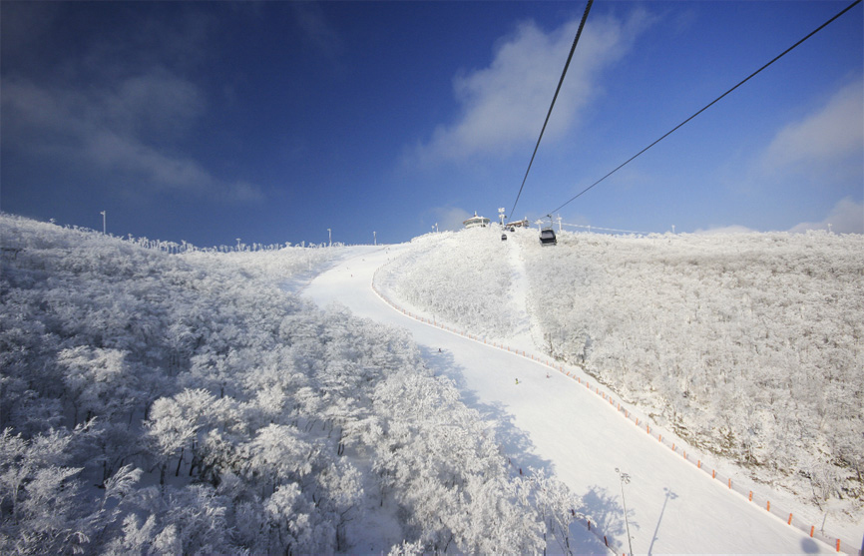
Holographic Confinement Phase Transition
Yi Yang@NCTU
February 6-10, 2017
IBS-KIAS-2017 @ High 1

Slide 2
Content
Confinement in holographic QCD
A Holographic QCD Model
- thermodynamics of background
- probe open strings
Conclusion

Slide 3
String Theory
SUSY
10-dimension
String and brane
or
open
closed

Slide 4
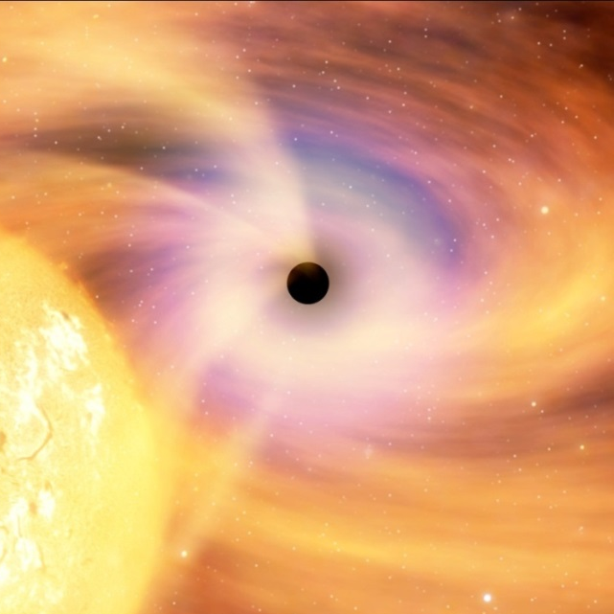
Many D-Branes and AdS

Slide 5
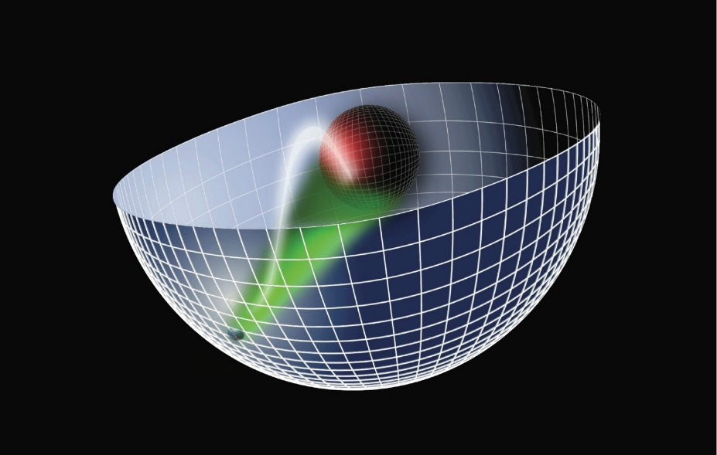
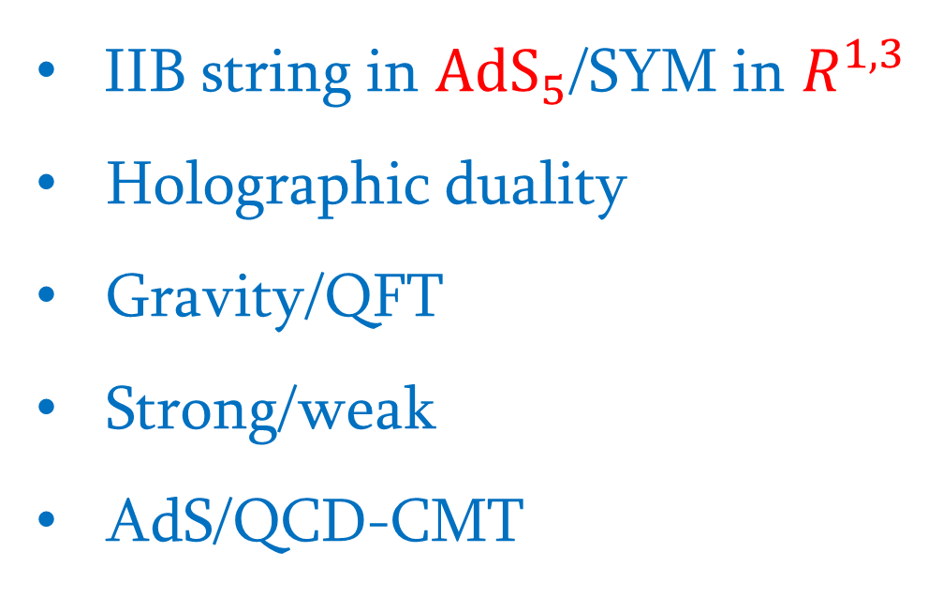
AdS/CFT Duality
IIB string in ${AdS}_{5}$/SYM in $R^{1,3}$
Holographic duality
Gravity/QFT
Strong/weak
AdS/QCD-CMT

Slide 6
Phases in QCD for $m=0$
χS deconfinment
T
χSB confinment
μ

Slide 7
Phases in QCD for Light Quarks
χS deconfinment
T
χSB confinment
μ

Slide 8

Phases in QCD for Heavy Quarks
T
Deconfinment
Confinment
μ

Slide 9





Geometric Realization
$$q$$
$$\overline{q}$$
$$R^{1,3}$$
meson
$$q$$
$$\overline{q}$$
free quarks

Slide 10



Geometric Realization of Confinement/deconfinement
$q$ $\overline{q}$
$q$ $\overline{q}$
$$R^{1,3}$$
confinement
deconfinement

Slide 11

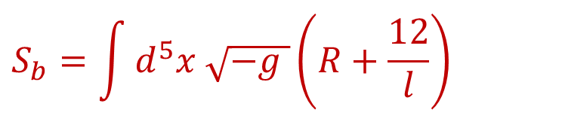
Schwatzchild-AdS Black Hole
$$S_{b}=\int{d^{5}x \sqrt{−g }\left(R+\frac{12}{l}\right)}$$
$$g=−g\left(r\right)dt^{2}+\frac{dr^{2}}{g\left(r\right)}+r^{2}dΩ^{2}$$
$$g\left(r\right)=1−\frac{2M}{r}+\frac{r^{2}}{l^{2}}$$
$$T=\frac{l^{2}+3r_{H}^{2}}{4π{r_{H}l}^{2}}→T_{min}=\frac{\sqrt{3}}{2l}$$

Slide 12



Shwatzchild-AdS Black Hole
$$T$$
Schwarzschild-AdS
Black hole
stable
unstable
$$T_{min}$$
Thermal gas
$$z_{H}$$

Slide 13
Confinment-Deconfinement
$$T$$
Schwarzschild-AdS
Black hole
stable
unstable
$$T_{min}$$
Thermal gas
$$z_{H}$$

Slide 14


QCD Phase Diagram
T
Deconfinment
$$T_{HP}$$
Confinment
$$μ$$

Slide 15
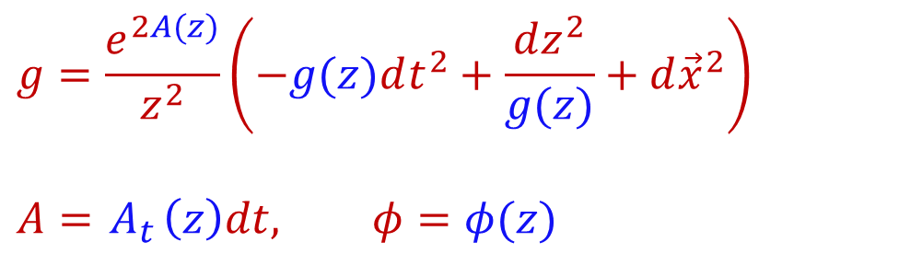
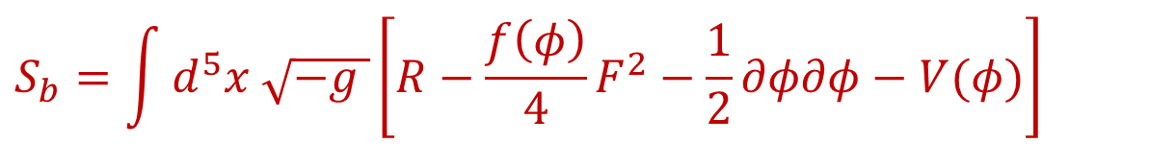
Einstein-Maxwell-Scalar
$$S_{b}=\int{d^{5}x \sqrt{−g }\left[R−\frac{f\left(φ\right)}{4}F^{2}−\frac{1}{2}∂φ∂φ−V(φ)\right]}$$
$$g=\frac{e^{2A(z)}}{z^{2}}\left(−g(z)dt^{2}+\frac{dz^{2}}{g(z)}+d{\vec{x}}^{2}\right)$$
$$A={ A}_{t}\left(z\right)dt, φ=φ(z)$$

Slide 16
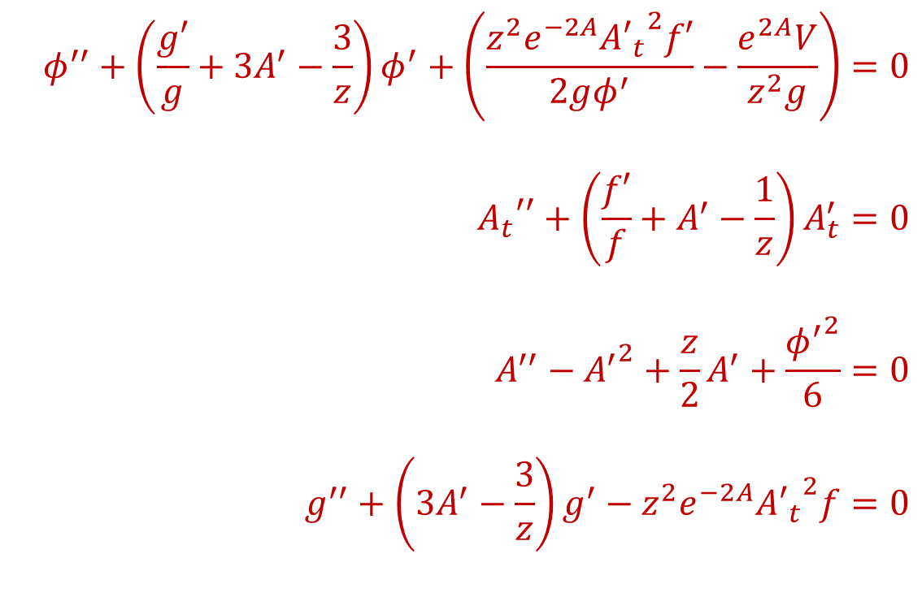
Equations of motion
$$φ^{′′}+\left(\frac{g′}{g}+3A^{′}−\frac{3}{z}\right)φ^{′}+\left(\frac{z^{2}e^{−2A}{{A′}_{t}}^{2}f′}{2gφ^{′}}−\frac{e^{2A}V}{z^{2}g}\right)=0$$
$${A_{t}}^{′′}+\left(\frac{f′}{f}+A^{′}−\frac{1}{z}\right)A_{t}^{′}=0$$
$$A^{′′}−{A^{′}}^{2}+\frac{z}{2}A^{′}+\frac{{φ^{′}}^{2}}{6}=0$$
$$g^{′′}+\left(3A^{′}−\frac{3}{z}\right)g^{′}−z^{2}e^{−2A}{{A′}_{t}}^{2}f=0$$

Slide 17
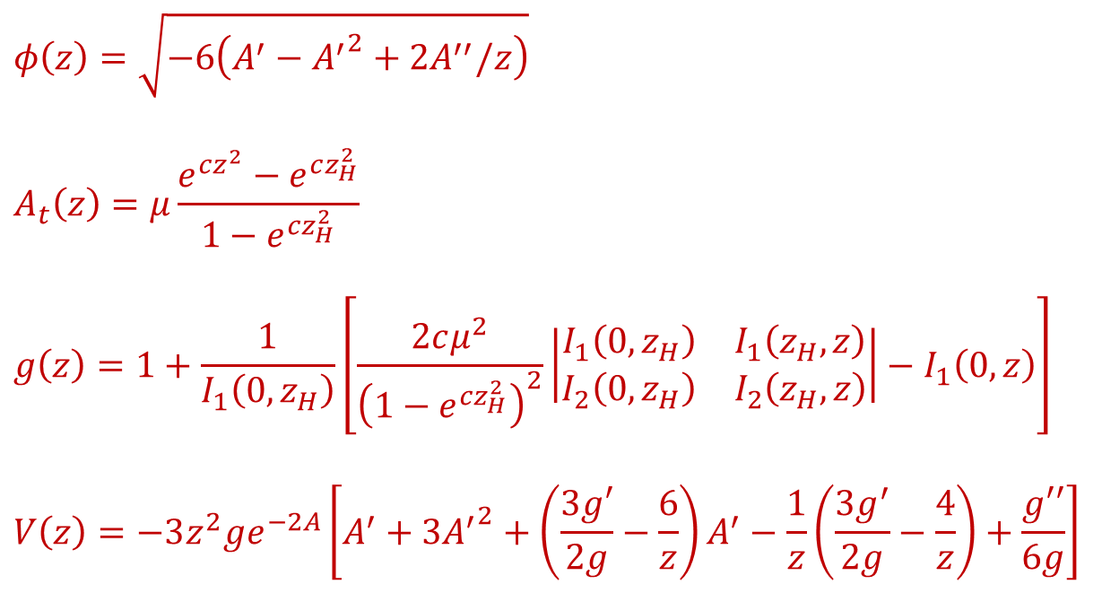
Analytic Solutions
$$φ\left(z\right)=\sqrt{−6\left(A^{′}−{A^{′}}^{2}+2A^{′′}/z\right)}$$
$$A_{t}\left(z\right)=μ\frac{e^{cz^{2}}−e^{cz_{H}^{2}}}{1−e^{cz_{H}^{2}}}$$
$$g\left(z\right)=1+\frac{1}{I_{1}\left(0,z_{H}\right)}\left[\frac{2cμ^{2}}{{\left(1−e^{cz_{H}^{2}}\right)}^{2}}\left|\begin{matrix}I_{1}\left(0,z_{H}\right) & I_{1}\left(z_{H},z\right) \\ I_{2}\left(0,z_{H}\right) & I_{2}\left(z_{H},z\right)\end{matrix}\right|−I_{1}\left(0,z\right)\right]$$
$$V\left(z\right)=−3z^{2}ge^{−2A}\left[A^{′}+3{A^{′}}^{2}+\left(\frac{3g′}{2g}−\frac{6}{z}\right)A^{′}−\frac{1}{z}\left(\frac{3g^{′}}{2g}−\frac{4}{z}\right)+\frac{g′′}{6g}\right]$$
$I_{1}\left(a,b\right)≡\int_{a}^{b}{x^{3}e^{−3A(x)}dx}$, $I_{2}\left(a,b\right)≡\int_{a}^{b}{x^{3}e^{cx^{2}−3A(x)}dx}$

Slide 18

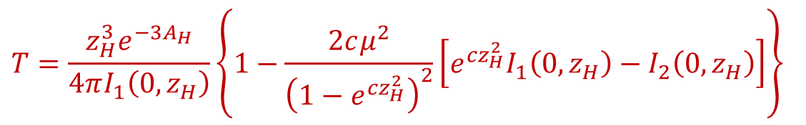
Temperature at finite μ
$$T=\frac{z_{H}^{3}e^{−3A_{H}}}{4πI_{1}\left(0,z_{H}\right)}\left\{1−\frac{2cμ^{2}}{{\left(1−e^{cz_{H}^{2}}\right)}^{2}}\left[e^{cz_{H}^{2}}I_{1}\left(0,z_{H}\right)−I_{2}\left(0,z_{H}\right)\right]\right\}$$

Slide 19

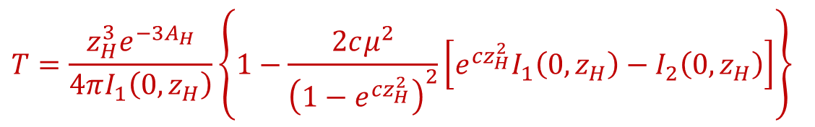




BH-BH Transition
$$T=\frac{z_{H}^{3}e^{−3A_{H}}}{4πI_{1}\left(0,z_{H}\right)}\left\{1−\frac{2cμ^{2}}{{\left(1−e^{cz_{H}^{2}}\right)}^{2}}\left[e^{cz_{H}^{2}}I_{1}\left(0,z_{H}\right)−I_{2}\left(0,z_{H}\right)\right]\right\}$$
$$T$$
$$T_{max}$$
$$T_{BB}$$
$$T_{min}$$
$$z_{H}$$
large
unstable
small

Slide 20
Always Deconfinement
$$T=\frac{z_{H}^{3}e^{−3A_{H}}}{4πI_{1}\left(0,z_{H}\right)}\left\{1−\frac{2cμ^{2}}{{\left(1−e^{cz_{H}^{2}}\right)}^{2}}\left[e^{cz_{H}^{2}}I_{1}\left(0,z_{H}\right)−I_{2}\left(0,z_{H}\right)\right]\right\}$$
$$T$$
$$T_{max}$$
$$T_{BB}$$
$$T_{min}$$
$$z_{H}$$
large
unstable
small

Slide 21
Free Energy

Slide 22

Deconfinement-Deconfinement
T
μ
$$μ_{c}$$

Slide 23


Open Strings Breaking
$$r$$
$$z_{m}$$

Slide 24
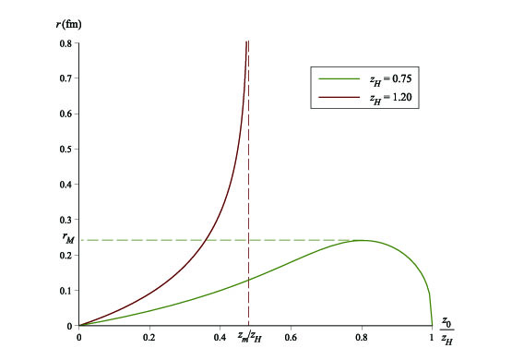
Dynamical Wall

Slide 25
Confinement-Deconfinement
Low Temperature
Small BH
Confinement
High Temperature
Large BH
Deconfinement

Slide 26
Confinement-Deconfinement
T
Deconfinement
Confinement
μ

Slide 27
Combining Background Phase and String Configurations
T
Deconfinement
Confinement
μ

Slide 28
QCD Phase Diagram
T
Deconfinement
Confinement
μ

Slide 29
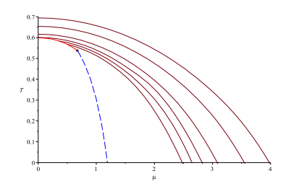
Meson Melting
$$V=2\int_{0}^{z_{0}}{dz{\frac{σ\left(z\right)}{g\left(z\right)}\left[1−\frac{σ^{2}\left(z_{0}\right)}{σ^{2}\left(z\right)}\right]}^{−1/2}}−2\int_{0}^{z_{H}}{dz}\frac{e^{2A(z)}}{z^{2}}$$

Slide 30
Conclusion
Gauge/gravity duality: holographic QCD
Black hole phase transition: background
Confinement/deconfinement: open strings
QCD phase diagram: combine two effects
Meson melting

